Slide 1
What do we talk about when We talk about feedback?

Slide 2
Main Title Subtitle
^{A}
^{B}
^{C}
^{D}
^{E}
^{F}

Slide 3
https://visible-learning.org/2013/02/john-hattie-helen-timperley-visible-learning-and-feedback/
Notes:
Helen Timperley and John Hattie meta data highlighted yesterday by Grzegorz Spiewak (gregorsh speevak) in his talk “A new science of effectiveness” –
We as teachers are feedback givers.
Nobody ever told me what it was.
It’s a big wide word like nice or god.
Are we all talking about the same thing?
In QAs I’m not so sure.
THIS TALK IS A JOURNEY THROUGH THE DEFINITIONS – I WANT TO TRY AND SHOW YOU THE JOURNEY I WENT ON WHEN I STARTED TO ASK WHAT FEEDBACK IS.
Its quite heavy on the quotes – there are going to be a lot of words on the screen - so be ready to take photos because you might need to cogitate later.

Slide 4
Is this feedback?
Notes:
2 minutes speaking to your partner about whether you think the 15 examples on the handout should be defined as feedback or not.

Slide 5
1)
2)
3)
4)
5)
6)
7)
8)
9)
10)
11)
12)
13)
14)
15)
Notes:
Before I give you what I consider to be the correct answers I should ask you question number 14:
DOES ANYONE HERE THINK THAT ALL 15 SITUATIONS REPRESENT FEEDBACK?

Slide 6
1) FEEDBACK
2) FEEDBACK
3) FEEDBACK
4) FEEDBACK
5) FEEDBACK
6) FEEDBACK
7) FEEDBACK
8) FEEDBACK
9) FEEDBACK
10) FEEDBACK
11) FEEDBACK
12) NOT FEEDBACK
13) NOT FEEDBACK
14) FEEDBACK
15) FEEDBACK
Notes:
Even laughing at a joke tells the joker whether they have been funny or not.
12 – you are naturally good – this is a general comment, not feedback. At least if this fits the definitions I’m going to look at then I need to go back to the drawing board. Naturally good – so you can relax and not try.
13 – a teacher habitually says good, well done. This is something I see (and do) a lot. The important word is “habit”. But it is meaningless praise. Evidence suggests over-praise is counter-productive
So on a gut level like most teacher I feel like I know what feedback is, but can the definitions of theorists reveal anything more useful?

Slide 7
What is feedback?
Notes:
Again with your partner – can you agree on what definition you would give feedback. What is it?
TAKE WORKING DEFINITIONS FROM A FEW VOLUNTEERS.
ANY SIGNIFICANT DIFFERENCES?
Well, lets start looking at some official definitions…

Slide 8
“Information about reactions to a product, a person's performance of a task, etc. which is used as a basis for improvement”
Google ‘define…’

Slide 9
“Information about reactions to a product, a person's performance of a task, etc. which is used as a basis for improvement”
Google ‘define…’
Notes:
Information – okay happy with that
Used as a basis for improvement – okay so even laughing at a joke – or not laughing can form a “basis”. So we still have a very wide definition here.

Slide 10
“Feedback is information a teacher or another speaker, including another learner, gives to learners on how well they are doing, either to help the learner improve specific points, or to help plan their learning ”
British Council website

Slide 11
“Feedback is information a teacher or another speaker, including another learner, gives to learners on how well they are doing, either to help the learner improve specific points, or to help plan their learning ”
British Council website
Notes:
Information – okay again
Gives to learners – I’m not sure about this – can’t feedback work both ways. We teachers need to get feedback from our learners too (assessment for learning) like my asking you to put your hands up earlier…information for me, so that I know more about what you know, or think you know…

Slide 12
“Feedback is information a teacher or another speaker, including another learner, gives to learners on how well they are doing, either to help the learner improve specific points, or to help plan their learning ”
British Council website
Notes:
Help – help improve, and help plan - now this is more useful.
Feedback is always supposed to help learning isn’t it? Does anyone give feedback to hinder learning? That’s not a teaching strategy I know.
And helping is always forward looking, isn’t it. You can’t help someone do something in the past. If they’ve done it, they’ve done it. But you can help them for next time.

Slide 13
“…feedback is conceptualized as information provided by an agent (e.g., teacher, peer, book, parent, self, experience) regarding aspects of one’s performance or understanding”.
Timperley & Hattie 2007
Notes:
This is a quote from The Power of Feedback based on their synthesis of research data.
We could argue that “regarding aspects” is a bit watery. I prefer “help, but they go on…

Slide 14
“…the main purpose of feedback is to reduce discrepancies between current understandings and performance and a goal”.
Timperley & Hattie 2007

Slide 15
“…the main purpose of feedback is to reduce discrepancies between current understandings and performance and a goal”.
Timperley & Hattie 2007
Notes:
Now we’re getting somewhere.
The main purpose – so we’re defining feedback in terms of the reason we do it. Why do you give feedback?
In order to
Reduce discrepancies between current …and goal.
So this is not just “help”, this is go from here, to here. You are here, you need to be here. Let’s reduce the discrepancy.

Slide 16
1) FEEDBACK
2) FEEDBACK
3) FEEDBACK
4) FEEDBACK
5) FEEDBACK
6) FEEDBACK
7) FEEDBACK
8) FEEDBACK
9) FEEDBACK
10) FEEDBACK
11) FEEDBACK
12) NOT FEEDBACK
13) NOT FEEDBACK
14) FEEDBACK
15) FEEDBACK
Notes:
Lets go back to the types of feedback from before.
WITH YOUR PARTNER PLEASE DECIDE WHETHER ALL OF THESE REMAINING FEEDBACK EXAMPLES FIT THE MOST RECENT DEFINITION
REMEMBER
INFORMATION TO REDUCE THE GAP BETWEEN WHERE LEARNERS ARE NOW AND A TARGET OR GOAL.
IM GOING TO SHOW YOU WHAT I THINK -

Slide 17
1) SUMMATIVE F’BACK
2) FEEDBACK
3) SUMMATIVE F’BACK
4) SUMMATIVE F’BACK
5) SUMMATIVE F’BACK
6) FEEDBACK
7) FEEDBACK
8) FEEDBACK
9) SUMMATIVE F’BACK
10) FEEDBACK
11) FEEDBACK
12) NOT FEEDBACK
13) NOT FEEDBACK
14) FEEDBACK
15) FEEDBACK
Notes:
I think these examples are all BACKWARDS LOOKING – in other words they are SUMMATIVE.
That’s not to say it’s bad feedback, it might be crucial in establishing a BASIS for improvement, but none of them will help reduce the gap.
They are not FORWARD LOOKING, they are not FORMATIVE.
OTHER EXAMPLES OF SUMMATIVE FEEDBACK
A grade for a piece of work
A tick against a correct sentence
The reply “that’s right” or “that’s not right” to a learner’s answer

Slide 18
“Feedback is information about the gap between the actual level and the reference level of a system parameter which is used to alter the gap in some way”
Ramaprasad 1983
Notes:
This is from Arkalgud Ramaprasad’s 1983 paper On the definition of Feedback.

Slide 19
“Feedback is information about the gap between the actual level and the reference level of a system parameter which is used to alter the gap in some way”
Ramaprasad 1983
Notes:
Means “goal”

Slide 20
“Feedback is information about the gap between the actual level and the goal which is used to alter the gap in some way”
Ramaprasad 1983
Notes:
So now we are talking about “information about the gap”
We could quibble about the use of “alter” here – reduce is better I think as we said before.

Slide 21
But what might this look like in the classroom?
Notes:
Feedback is information about the gap between current performance and goal.
But what would that information look like in the classroom, and how would you provide it?
It depends on what your teaching of course, but for two minutes discuss with your partner any ideas you might have
Then I’ll give you five possible suggestions..

Slide 22
But what might this look like in the classroom?
“Feedback is information about the gap between the actual level and the goal which is used to alter the gap in some way”

Slide 23
Modelling correct pronunciation after hearing an error and requiring the learner to copy the model.
Writing comments on a piece of written work with suggestions about how and where to make improvements.
Discussing with learners what is good about an exemplary piece of writing, or what is bad about a poor one; and comparing that piece of work to their own.
Noting down grammatical errors while monitoring group work, then writing them on the IWB and discussing corrections when the activity has finished.
Suggesting a more complex formulation of a learner utterance, or a formulation of a more appropriate register.

Slide 24
“The traditional definition of feedback is … too narrow to be of much use, and … a more appropriate conception … requires knowledge of the standard or goal … and the development of ways and means for reducing the discrepancy between what is produced and what is aimed for.”
Sadler 1989
Notes:
This is Royce Sadler from the university of Queensland in1989.
“Formative assessment and the design of instructional systems”

Slide 25
“The traditional definition of feedback is … too narrow to be of much use, and … a more appropriate conception … requires knowledge of the standard or goal … and the development of ways and means for reducing the discrepancy between what is produced and what is aimed for.”
Sadler 1989
Notes:
He says too narrow – I say too wide. We’ll agree to differ.

Slide 26
“The traditional definition of feedback is … too narrow to be of much use, and … a more appropriate conception … requires knowledge of the standard or goal … and the development of ways and means for reducing the discrepancy between what is produced and what is aimed for.”
Sadler 1989
Notes:
Fits in with what we’ve seen so far

Slide 27
“(P)roviding direct and authentic evaluative experience is a necessary (instrumental) condition for the development of evaluative expertise and therefore for intelligent self-monitoring. It is insufficient for students to rely upon evaluative judgments made by the teacher.”
Sadler 1989
Notes:
He continues in an interesting way…

Slide 28
“(P)roviding direct and authentic evaluative experience is a necessary (instrumental) condition for the development of evaluative expertise and therefore for intelligent self-monitoring. It is insufficient for students to rely upon evaluative judgments made by the teacher.”
Sadler 1989
Notes:
This introduces a whole new idea.
EVALUATIVE EXPERTISE

Slide 29
“(P)roviding direct and authentic evaluative experience is a necessary (instrumental) condition for the development of evaluative expertise and therefore for intelligent self-monitoring. It is insufficient for students to rely upon evaluative judgments made by the teacher.”
Sadler 1989
Notes:
EVALUATIVE EXPERTISE
AND
INTELLIGENT SELF MONITORING
These are new ideas because now feedback is not only reducing the gap but helping the students work out how to do it for themselves

Slide 30
“(P)roviding direct and authentic evaluative experience is a necessary (instrumental) condition for the development of evaluative expertise and therefore for intelligent self-monitoring. It is insufficient for students to rely upon evaluative judgments made by the teacher.”
Sadler 1989
Notes:
And the idea of development here means that we think of feedback not in terms of a single “hit” of help, but part of a developmental process which takes place over time. Even if you only teach the student for a week, every bit of feedback is contributing, potentially, to their ongoing training in MONITORING AND EVALUATING THEIR OWN PERFORMANCE.

Slide 31
“(P)roviding direct and authentic evaluative experience is a necessary (instrumental) condition for the development of evaluative expertise and therefore for intelligent self-monitoring. It is insufficient for students to rely upon evaluative judgments made by the teacher.”
Sadler 1989
Notes:
Why – because we, the teachers, won’t always be there for them.
Whatever evaluations of their performance we teachers are making, they have to be able to make for themselves when they are out there in the real world.

Slide 32
"Effective feedback must answer three major questions asked by a teacher and/or by a student: Where am I going? …How am I going? …and Where to next? …These questions correspond to notions of feed up, feed back, and feed forward"
Timperley & Hattie 2007
Notes:
Timperley and Hattie created a sort of framework for developing this expertise 18 years later…

Slide 33
"Effective feedback must answer three major questions asked by a teacher and/or by a student: Where am I going? …How am I going? …and Where to next? …These questions correspond to notions of feed up, feed back, and feed forward"
Timperley & Hattie 2007

Slide 34
"Effective feedback must answer three major questions asked by a teacher and/or by a student: Where am I going? …How am I going? …and Where to next? …These questions correspond to notions of feed up, feed back, and feed forward"
Timperley & Hattie 2007

Slide 35
"Effective feedback must answer three major questions asked by a teacher and/or by a student: Where am I going? …How am I going? …and Where to next? …These questions correspond to notions of feed up, feed back, and feed forward"
Timperley & Hattie 2007

Slide 36
"Effective feedback must answer three major questions asked by a teacher and/or by a student: Where am I going? …How am I going? …and Where to next? …These questions correspond to notions of feed up, feed back, and feed forward"
Timperley & Hattie 2007

Slide 37
"Effective feedback must answer three major questions asked by a teacher and/or by a student: Where am I going? …How am I going? …and Where to next? …These questions correspond to notions of feed up, feed back, and feed forward"
Timperley & Hattie 2007

Slide 38
"Effective feedback must answer three major questions asked by a teacher and/or by a student: Where am I going? …How am I going? …and Where to next? …These questions correspond to notions of feed up, feed back, and feed forward"
Timperley & Hattie 2007

Slide 39
Effective feedback asks…
What are the goals? feed up
2) What progress is being made toward the goal? feed back
3) What activities need to be undertaken to make better progress? feed forward
Timperley & Hattie 2007
Notes:
Now we have three, neater and more precise ideas to deal with, rather than one big flabby one.
Feed up – students have to know what they are aiming for
Feed back – this could be summative, what is good or bad about what they are doing at the moment
Feed forward – what do they need to do to improve.
IN ONE MINUTE COULD YOU THINK OF HOW THIS WOULD WORK IN CLASS – EXAMPLES OF WHAT YOU COULD DO THAT WOULD HELP A STUDENT DEVELOP THEIR ABILITY TO ASK THEMSELVES THESE THREE QUESITONS

Slide 40
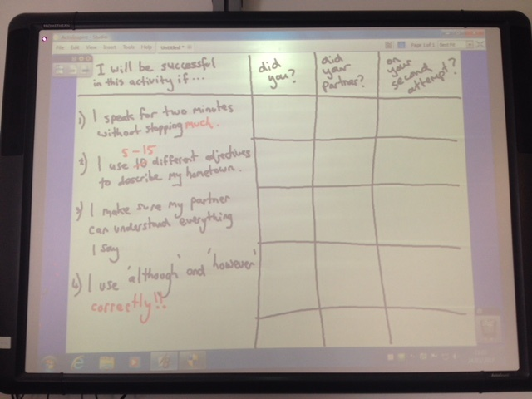
Objective: to complete an IELTS speaking Part Two in a way that would impress an examiner.
Notes:
Success criteria

Slide 41
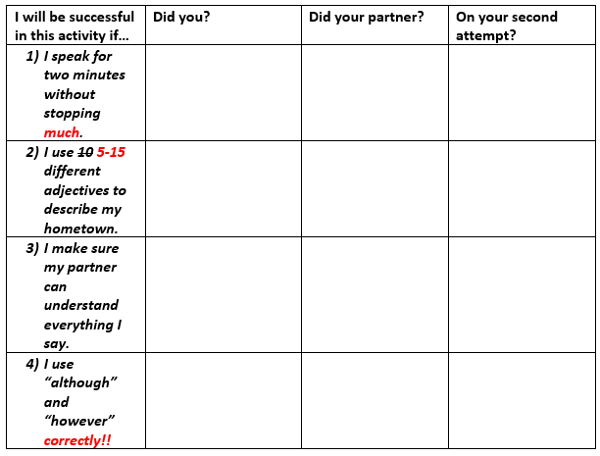
Notes:
The use of SC can be directly analogous to Timperley and Hatties questions
Feed up – establishing a learning objective, negotiating this with the student(s), encouraging them to set their own, for each other
Feed back – developing the criteria together, looking at good/bad models, asking students to write their own
Feed forward – beginning with single self-assessed criterion, asking peers to comment on each others performance with increasing (or increasingly challenging) criteria
MACRO LEVEL FEEDBACK
MICRO LEVEL – modelled pron=objective; comparison with student pron=criteria; student re-formulating develops ability to feed forward.

Slide 42
Feedback is too wide a term to be useful on its own
Feedback can be seen as summative or formative
While there is a place for summative feedback, formative feedback is more useful in developing language skills
Formative feedback is most effective when it provides students with goals, an awareness of progress towards the goals, and an understanding of where they need to go next
It is highly desirable that learners develop their ability to evaluate their own performance
Learning objectives and success criteria are able to provide a frame within which effective feed up, feed back, and feed forward can occur and learners can develop their ability to self-monitor

Slide 43
1) SUMMATIVE F’BACK
2) FEEDBACK
3) SUMMATIVE F’BACK
4) SUMMATIVE F’BACK
5) SUMMATIVE F’BACK
6) FEEDBACK
7) FEEDBACK
8) FEEDBACK
9) SUMMATIVE F’BACK
10) FEEDBACK
11) FEEDBACK
12) NOT FEEDBACK
13) NOT FEEDBACK
14) FEEDBACK
15) FEEDBACK
Notes:
Back to these – which ones could be considered EFFECTIVE using Timperley and Hatties questions?

Slide 44
1) SUMMATIVE F’BACK
2) EFFECTIVE FEEDBACK
3) SUMMATIVE F’BACK
4) SUMMATIVE F’BACK
5) SUMMATIVE F’BACK
6) FEEDBACK
7) EFFECTIVE FEEDBACK
8) FEEDBACK
9) SUMMATIVE F’BACK
10) EFFECTIVE FEEDBACK
11) EFFECTIVE F’BACK
12) NOT FEEDBACK
13) NOT FEEDBACK
14) EFFECTIVE F’BACK*
15) FEEDBACK
*for the teacher – Assessment for Learning.
Notes:
10 - perhaps the teacher should model – but this request by the teacher will begin a conversation about which the key content words are, and lead to a potential for peer comments on performance as to whether criteria have been fulfilled.

Slide 45
6)
A teacher writes gr. next to a grammar error in a piece of writing.
8)
A student explains to a teacher what they found difficult about a lesson.
15)
A teacher repeats an incorrectly formed statement back to a student, emphasising the key words of the statement with a questioning intonation.

Slide 46
Success Criteria you could set for reading
Read one paragraph aloud without pauses between the words or stumbling over words.
Read one paragraph aloud with no mispronunciations of words.
Read a page of my book and feel that I have understood what happened. (then check words in dictionary)
(lower levels) Read and copy 5-10 words (or even short sentences at mid-to-higher-levels) that are flashed on the IWB for short periods of time.
An efficient reader (of different levels) of this paragraph will: complete the reading in (3) minutes…underline any unknown words or phrases…not allow your mind to wander…not look up from the paragraph while reading…identify the beginning and end of each sentence…consciously read through the paragraph with an ‘inner voice’…

Slide 47
Success Criteria you could set for listening
Complete a dictogloss of a 20 second piece of speaking (fifty words) and, listening 5 times, achieve 90% accuracy (no more than 5 words wrong- spelling errors allowed).
(lower levels) Write down the 5-10 words read out by the teacher.
Correctly identify the odd-one-out of word groups (or sentence groups) read out by the teacher (at a level-appropriate speed).
Listen to (e.g.) a short recording and identify which tenses the speaker uses.
An efficient listener (of different levels) of this text will: focus only on the voice of the speaker…close your eyes and imagine the face of the person speaking…attempt to ‘lock back in’ to the voice if you get lost off…not panic of you get lost off…

Slide 48
chris.edgoose@bellenglish.com

Slide 49
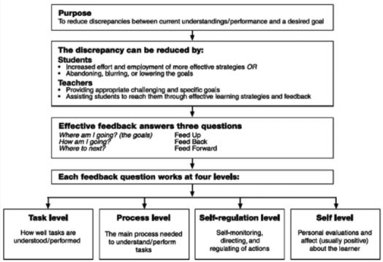
https://visible-learning.org/2013/02/john-hattie-helen-timperley-visible-learning-and-feedback/

