Slide 1
Projekt Erasmus +
Učíme cudzí jazyk s európskym srdcom
Trvanie projektu: 1.7.2019 – 30.06.2020

Slide 2
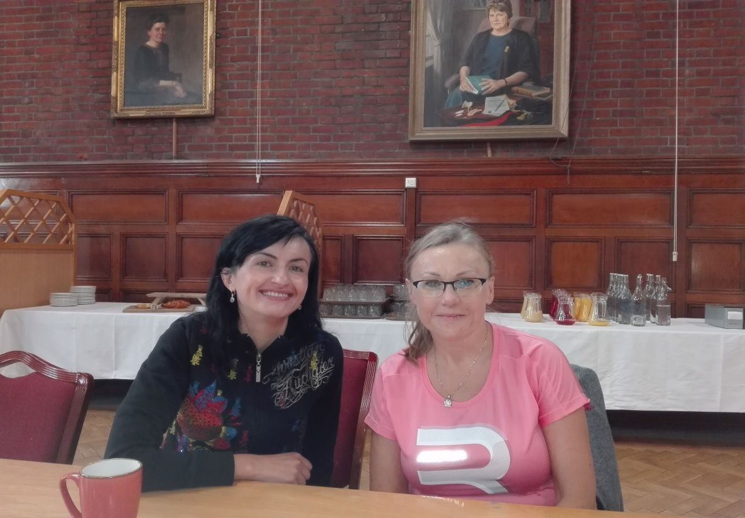
Language courses
Bell Teacher Campus, Homerton College,
Cambridge
Mgr. Silvia Baláková, Mgr. Alena Košutová

Slide 3
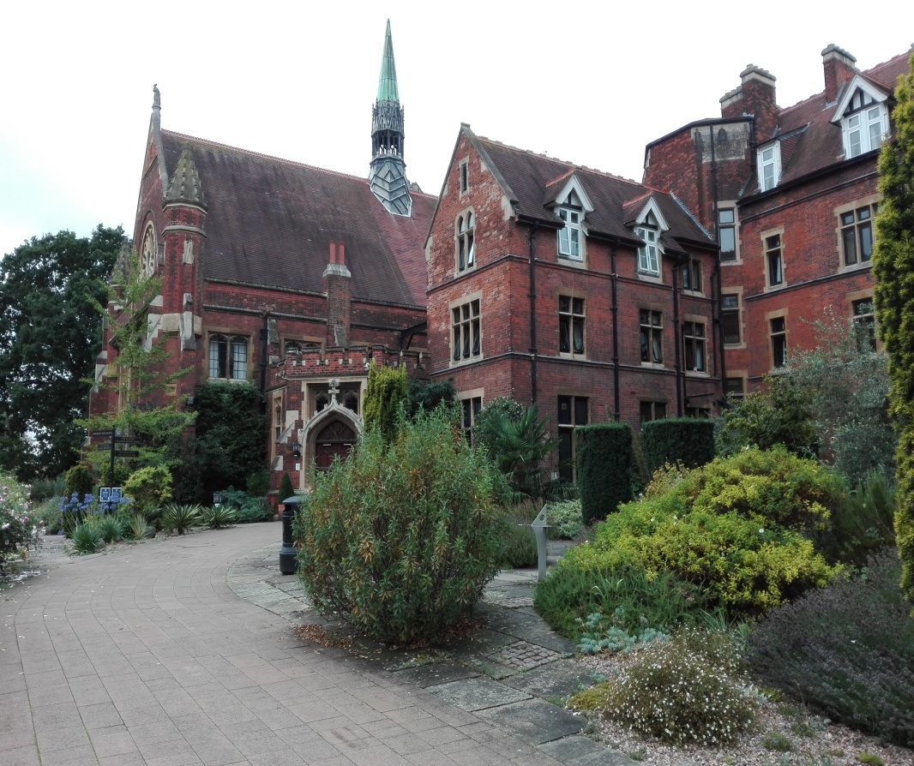
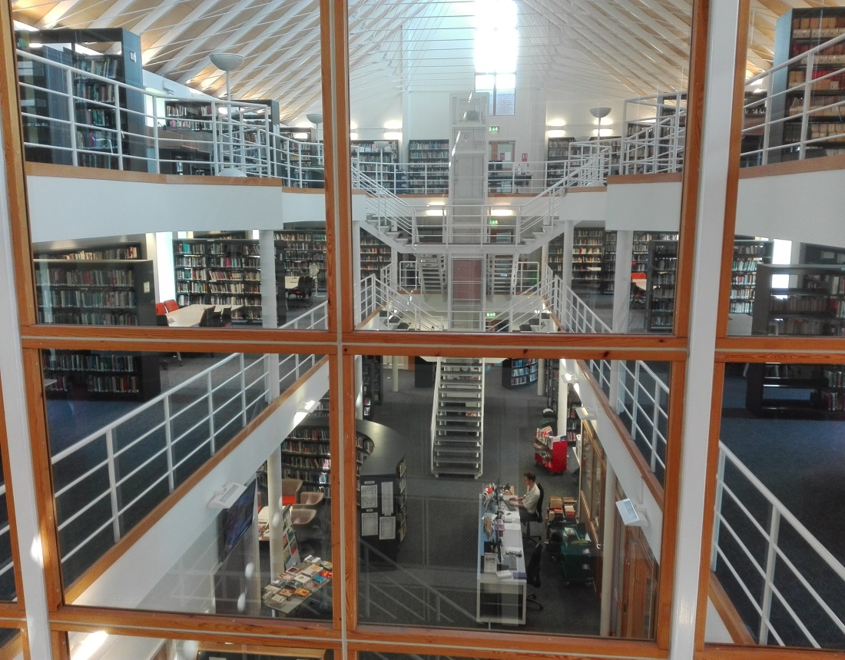
Language and Methodology Refresher – Linda Yale
- rozšírenie metód a techník vyučovania
angličtiny – diskusie, skupinové práce ....

Slide 4
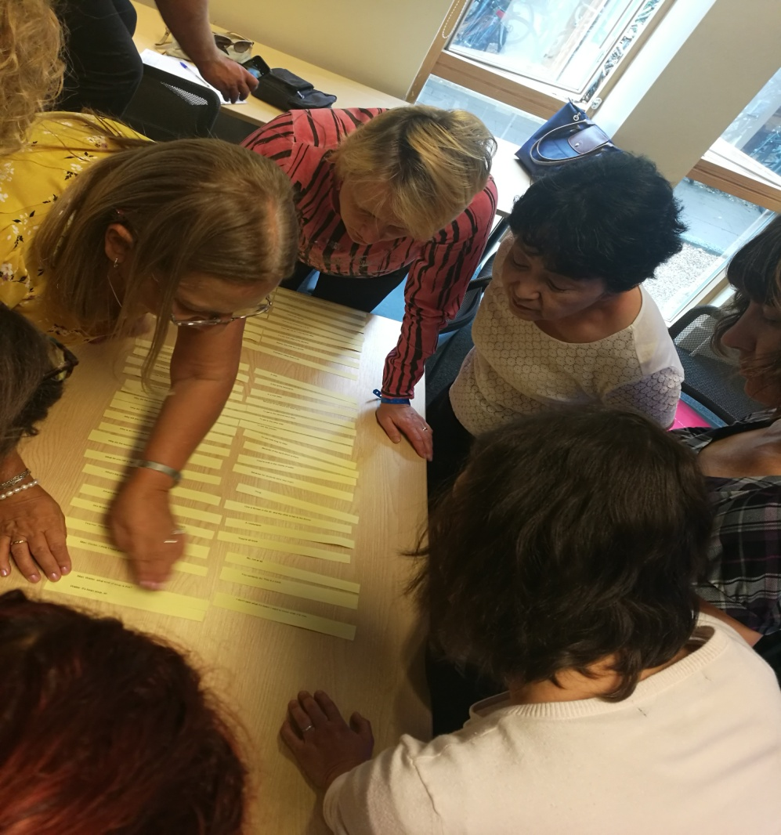
Language and Methodology Refresher
Zvýšenie motivácie
Zdokonalenie písania
Diskusie – kritické
myslenie
Čítanie jigsaws
Použitie krátkych
príbehov, básní
Použitie obrázkov,
idiómov, rýmov a hádaniek....

Slide 5
Workshops, Cultural, Plenary talks
How do I feed back?
Mind the gap: low-prep differentiation for busy teachers
Serious fun for lower – level learners
Hidden Cambridge
The most interesting places to stay in the UK
Reading – Peter Watkins
Databáza materiálov, postupov, prezentácií:
https://zskrusetnica.edupage.org/a/erasmus

Slide 6
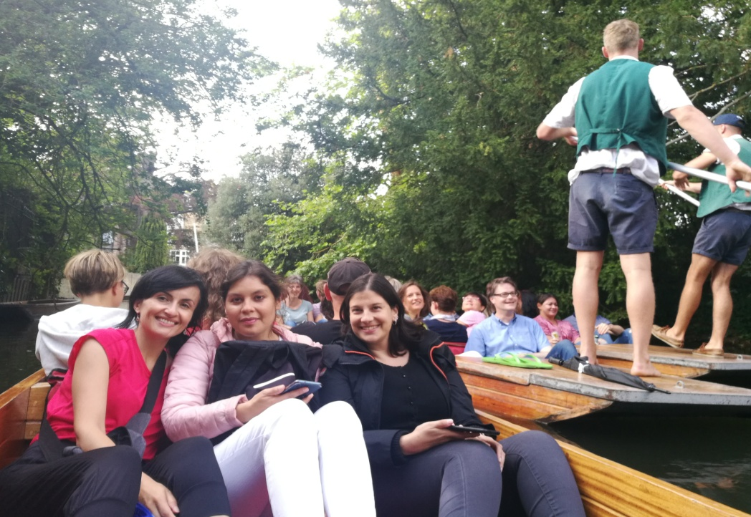
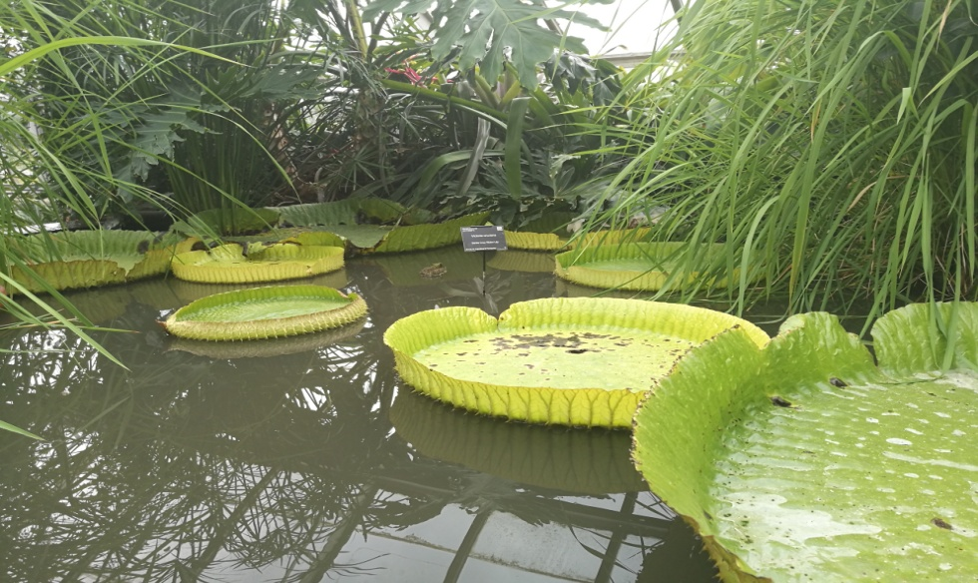
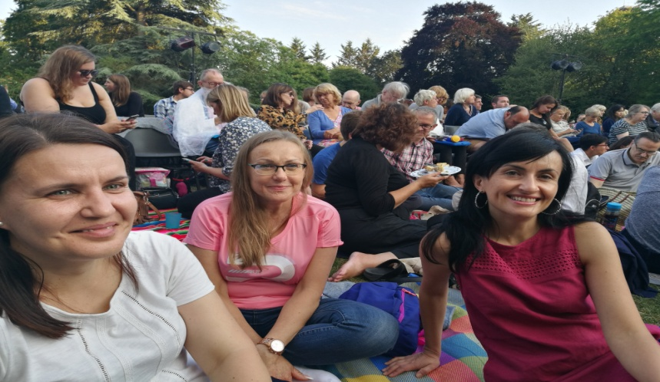
Cultural programme
Live Music – Kyle Chater
Trip to Ely
Trip to London
Punting
Cambridge
University Botanic Garden
Shakespeare Festival
- The Tempest

Slide 7
Using a Poem in the Classroom
William Blake – A P................T...
Topic – Friendship
Age, Level – 13,14 years – A2
Key Vocabulary - a friend, a foe, wrath,
behaviour, an extreme anger, wiles
Material: photocopies of the poem, worksheet for each learner

Slide 8
Procedure (Forming groups) a.) Pre – reading activity (Brainstorming, discussion about good and bad friend)
„Who do you consider a good friend?“
„ Which characteristics do you appreciate about him/her? ( five notions on the board). “
„ Write three statements about the typical behaviour of a good friend. “
„ When might your friend become an enemy? “

Slide 9
b.) Predict the content of the poem
some information about the poet
reading the first two lines of the poem
„ What is the poem going to be about?“
tree, poisonous tree – What does it mean?

Slide 10
c.) Putting lines into the correct order
work with jumbled lines of one stanza in each group of three- four learners
comparison with the correct order
reading all ordered stanzas after their correction

Slide 11
d.) Translation of the poem
learners in groups translate one stanza of the poem into the mother tongue
re-translation into the foreign language
comparison with the original whole poem

Slide 12
e.) Searching for the message of the poem
initiation the dialogue by reflecting on the title of the poem
invite the learners to find out what moral the poet wants to indicate to us.
highlighting with coloured pens the key words of the poem
leading discussion towards the message
( longing hatred and anger is dangerous.....)

Slide 13
Practising grammar in funny ways
Irregular verb „aerobics“
What´s happend? – Learners have to describe their picture. There is/ are a man... She is sitting ...
Their partner should say, She´s hurt her knee.
Present perfect to express action in the past with result important now.

Slide 14
Ďakujem za pozornosť.

